Slide 1

Customer Shopping Behavior Analysis
Uncovering insights from 3,900 purchases to guide strategic business decisions through data-driven analysis of spending patterns, customer segments, and product preferences.

Slide 2
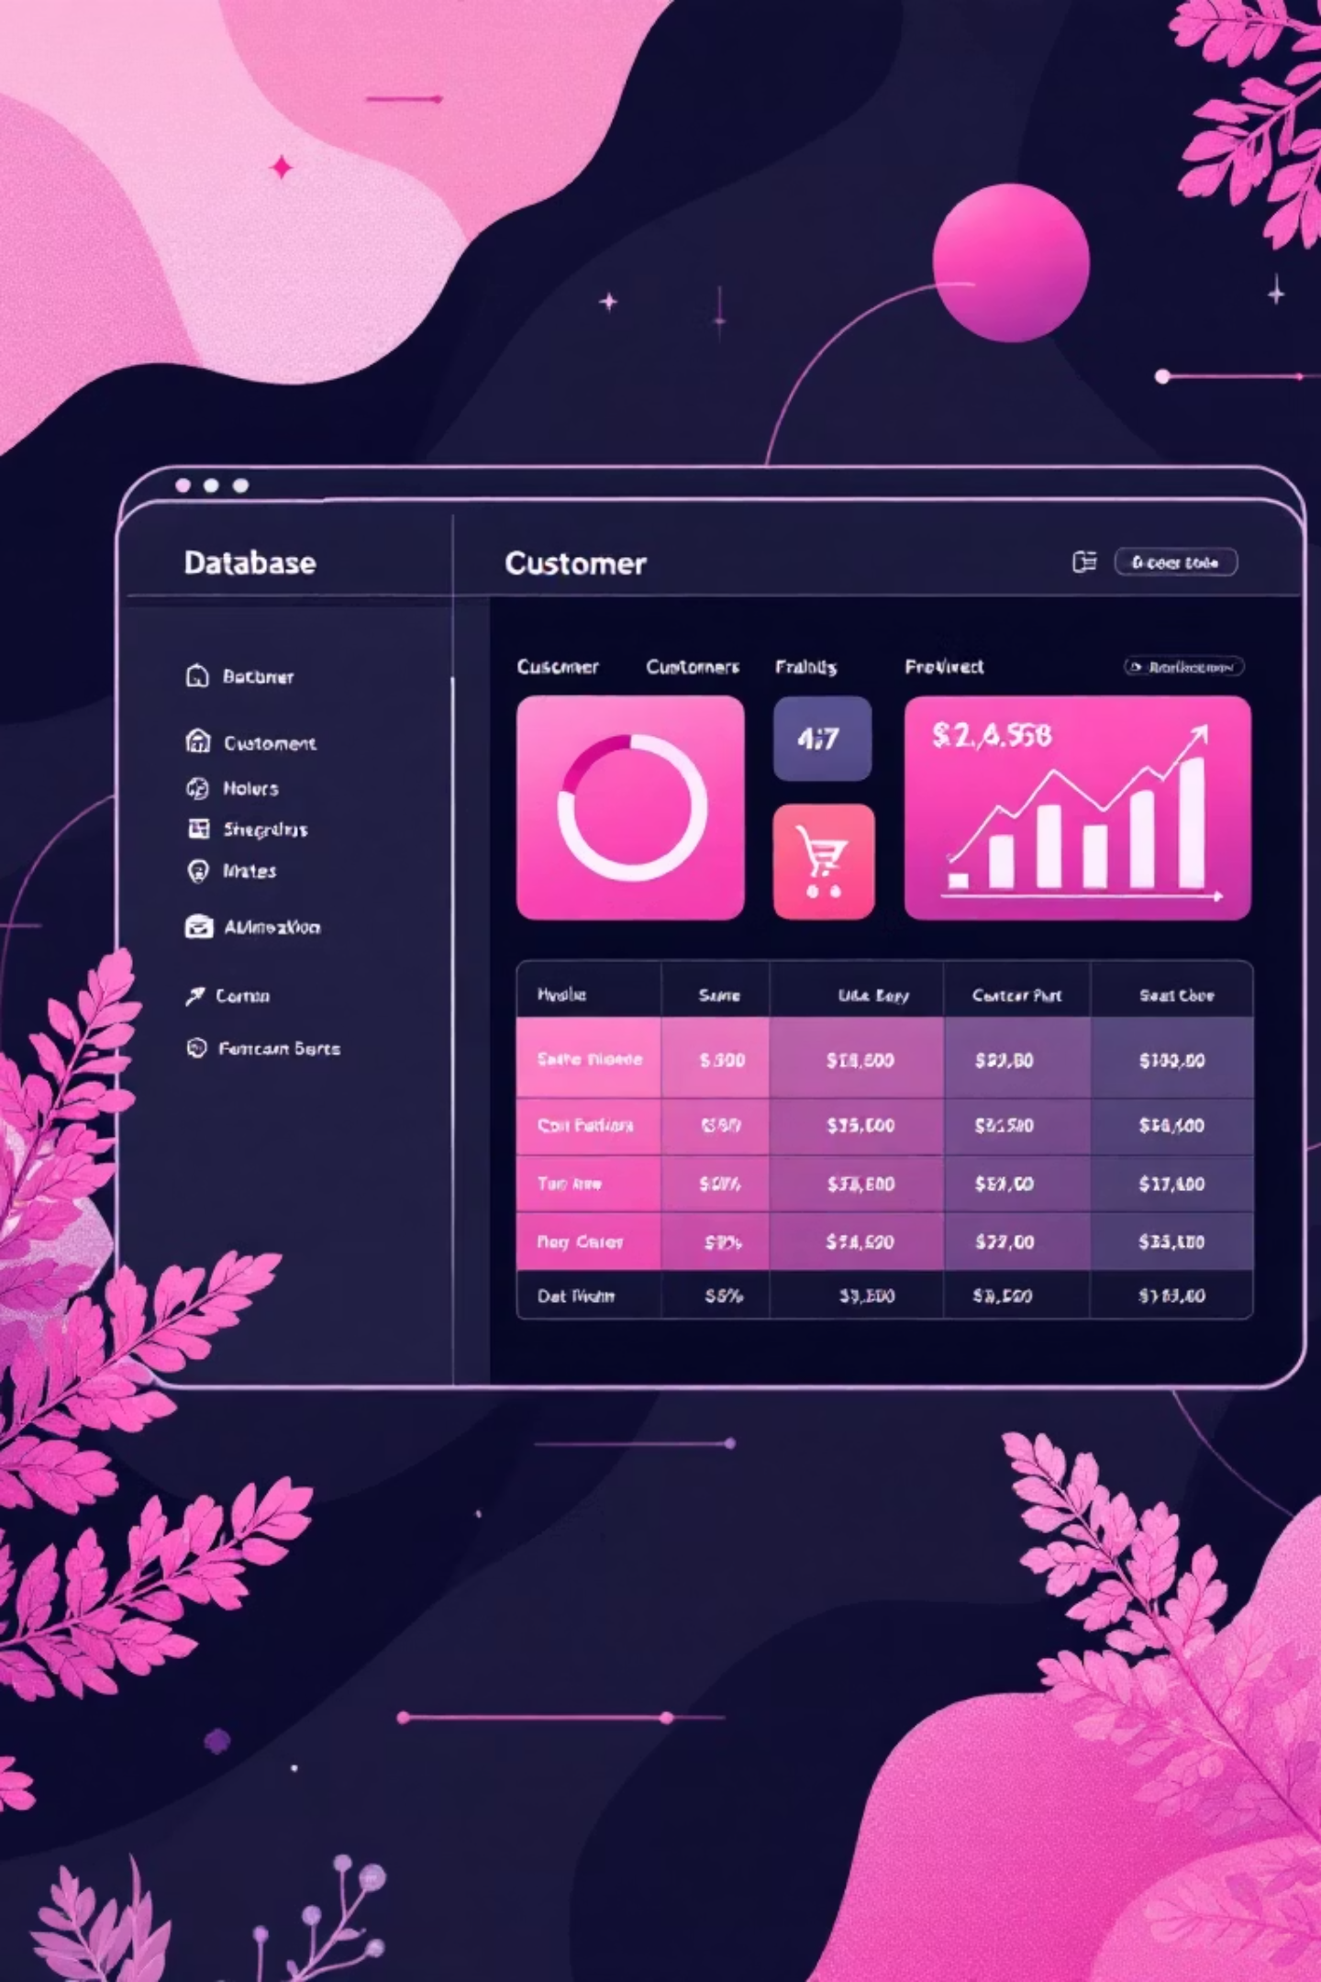
Dataset Overview
3,900
18
50
Total Purchases
Data Features
Locations
Customer demographics and purchase details
Geographic distribution across regions
Comprehensive transactional data analyzed
25
Product Types
Diverse items across four categories

Slide 3
Data Preparation & Cleaning
01
02
Data Loading & Exploration
Missing Data Handling
Imported dataset using pandas and performed initial structure analysis with summary statistics.
Imputed 37 missing Review Rating values using median rating by product category.
03
04
Feature Engineering
Database Integration
Created age_group bins and purchase_frequency_days columns for deeper analysis.
Connected to PostgreSQL and loaded cleaned data for SQL business analysis.

Slide 4

Revenue Insights
Gender Revenue Comparison
Male customers generated $157,890 in total revenue, significantly outpacing female customers at $75,191.
Age Group Performance
Young Adults lead revenue generation at $62,143, followed closely by Middle-aged customers at $59,197.

Slide 5

Customer Segmentation Analysis
Loyal Customers
Returning Buyers
3,116 customers (80%) form the core base with consistent purchase history.
701 customers (18%) show repeat purchase behavior and growth potential.
New Customers
83 customers (2%) represent fresh acquisition opportunities.

Slide 6
Product Performance Highlights
Top-Rated Products
Category Leaders
Gloves - 3.86 average rating
Clothing: Blouse, Pants, Shirt
Sandals - 3.84 average rating
Accessories: Jewelry, Sunglasses, Belt
Boots - 3.82 average rating
Footwear: Sandals, Shoes, Sneakers
Hat - 3.80 average rating
Outerwear: Jacket, Coat
Skirt - 3.78 average rating

Slide 7



Subscription & Discount Behavior
27%
50%
73%
Subscription Rate
Discount Usage
Non-Subscribers
1,053 customers with active subscriptions
Hat leads with highest discount rate
2,847 customers without subscriptions
Subscribers average $59.49 per purchase while non-subscribers spend $59.87. Interestingly, 839 customers used discounts but still spent above the average purchase amount.

Slide 8
Shipping Preferences
Express Shipping
Standard Shipping
Free Shipping
Average purchase: $60.48
Average purchase: $58.46
Most popular option at 675 orders
Higher-value orders prefer faster delivery
Most common choice for regular orders
Strong driver of purchase decisions

Slide 9
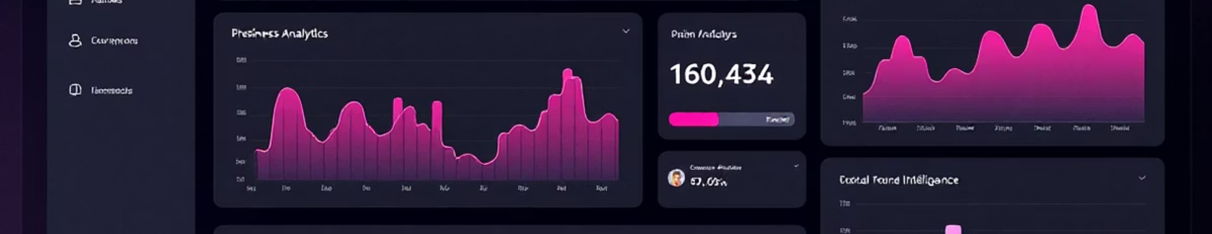

Key Dashboard Metrics
3.9K Customers
$59.76 Average
3.75 Rating
Total customer base analyzed
Mean purchase amount per transaction
Average customer review score

Slide 10




Strategic Recommendations
Boost Subscriptions
Promote exclusive benefits to convert the 73% non-subscriber base and increase recurring revenue.
Customer Loyalty Programs
Reward repeat buyers to move 701 returning customers into the loyal segment.
Review Discount Policy
Balance sales boosts with margin control, especially for high-discount products like hats.
Targeted Marketing
Focus on high-revenue age groups and express-shipping users for maximum ROI.

